Slide 1

“Corner Extraction”
Mikołaj Leszczuk

Slide 2
Theoretical Fundamentals
Corner Extraction == Corner Detection
Approach used within computer vision systems to:
Extract certain kinds of features
Infer contents of image
Usage:
Motion detection
Image registration
Video tracking
Image mosaicking
Panorama stitching
3D modelling
Object recognition

Slide 3
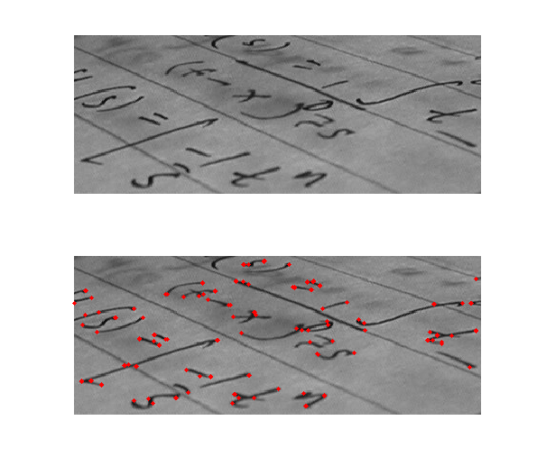
Corner Definitions
Intersection of 2 edges
Point for which there are 2 dominant & different edge directions in local neighbourhood of point

Slide 4
Interest Point Definition
Point in image:
Having well-defined position, &
Robustly detectable
Examples:
Corner
Isolated point of local intensity:
Maximum, or
Minimum
Line endings
Point on curve with locally maximal curvature

Slide 5
Corners vs. Interest Points
In practice, most so-called corner detection methods detecting interest points in general
In fact, term corner & interest point (& also feature) used more or less interchangeably & confusingly through literature
As consequence, if only corners to be detected – necessary to do local analysis of detected interest points to determine real corners

Slide 6
Robustness/Quality of Corner Detectors
Not usually very robust
Often requiring large redundancies introduced to prevent effect of individual errors from dominating recognition task
Determination of quality of corner detector – its ability to detect same corner in multiple similar images, under conditions of different:
Lighting
Translation
Rotation
Other transforms

Slide 7
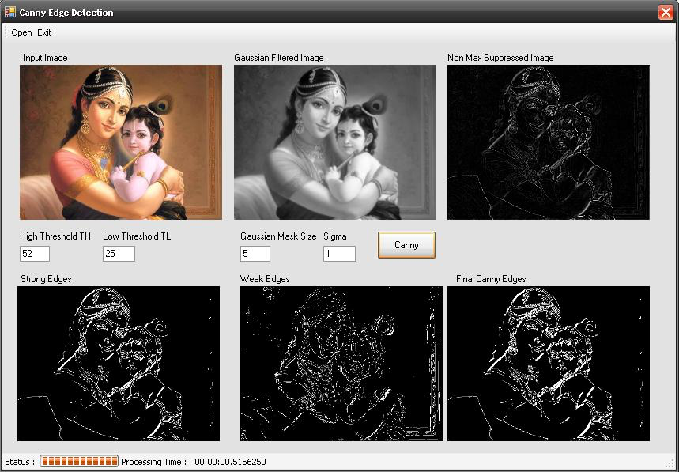
Algorithms for Corner & Edge Extraction: Canny Edge Detector
Operator using multi-stage algorithm:
Apply Gaussian filter to smooth image in order to remove noise
Find intensity gradients of image
Apply non-maximum suppression to get rid of spurious response to edge detection
Apply double threshold to determine potential edges
Track edge by hysteresis: finalize detection of edges by suppressing all other edges:
Weak
Not connected to strong edges
Detecting wide range of edges in images

Slide 8
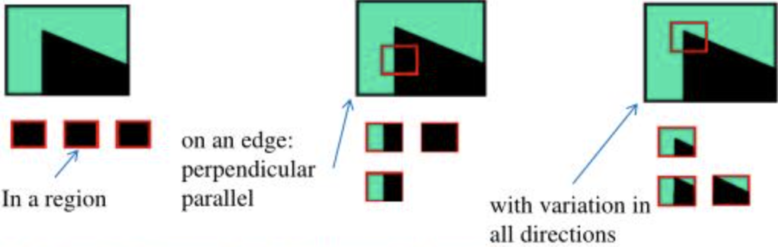
Algorithms for Corner & Edge Extraction: Moravec Corner Detector
One of earliest corner detection algorithms
Defining corner to be point with low self-similarity
Testing each pixel in image to look for corner presence
Similarity measured by taking Sum of Squared Differences (SSD) between 2 patches
Lower number indicating more similarity

Slide 9
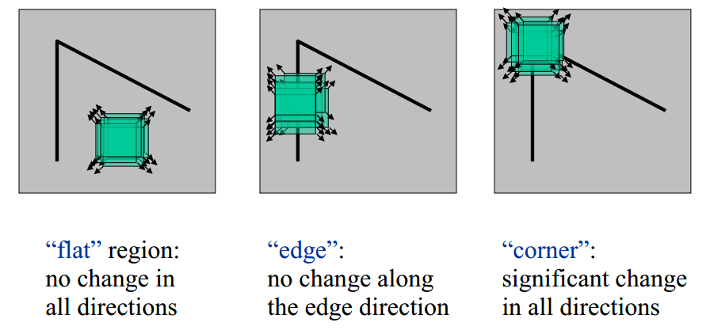
Algorithms for Corner & Edge Extraction: Harris Corner Detector (Operator)
Algorithm:
Finding points with large corner response function R (R > threshold)
Taking points of local maxima of R
Improved upon Moravec’s corner detector by considering differential of “corner score” with respect to direction directly, instead of using shifted patches
Corner score – autocorrelation
Proved to be more accurate in distinguishing between edges & corners

Slide 10
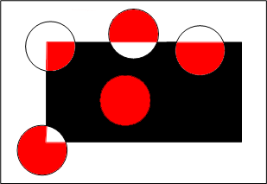
Algorithms for Corner & Edge Extraction: SUSAN Corner Detector
SUSAN – Smallest Uni-value Segment Assimilating Nucleus
Placing circular mask over pixel to be tested (nucleus)
Every pixel compared to nucleus using comparison function

Slide 11
Thank You for Your Attention!

